Slide 1



Remembering the Fallen October 7, 2023

Slide 2
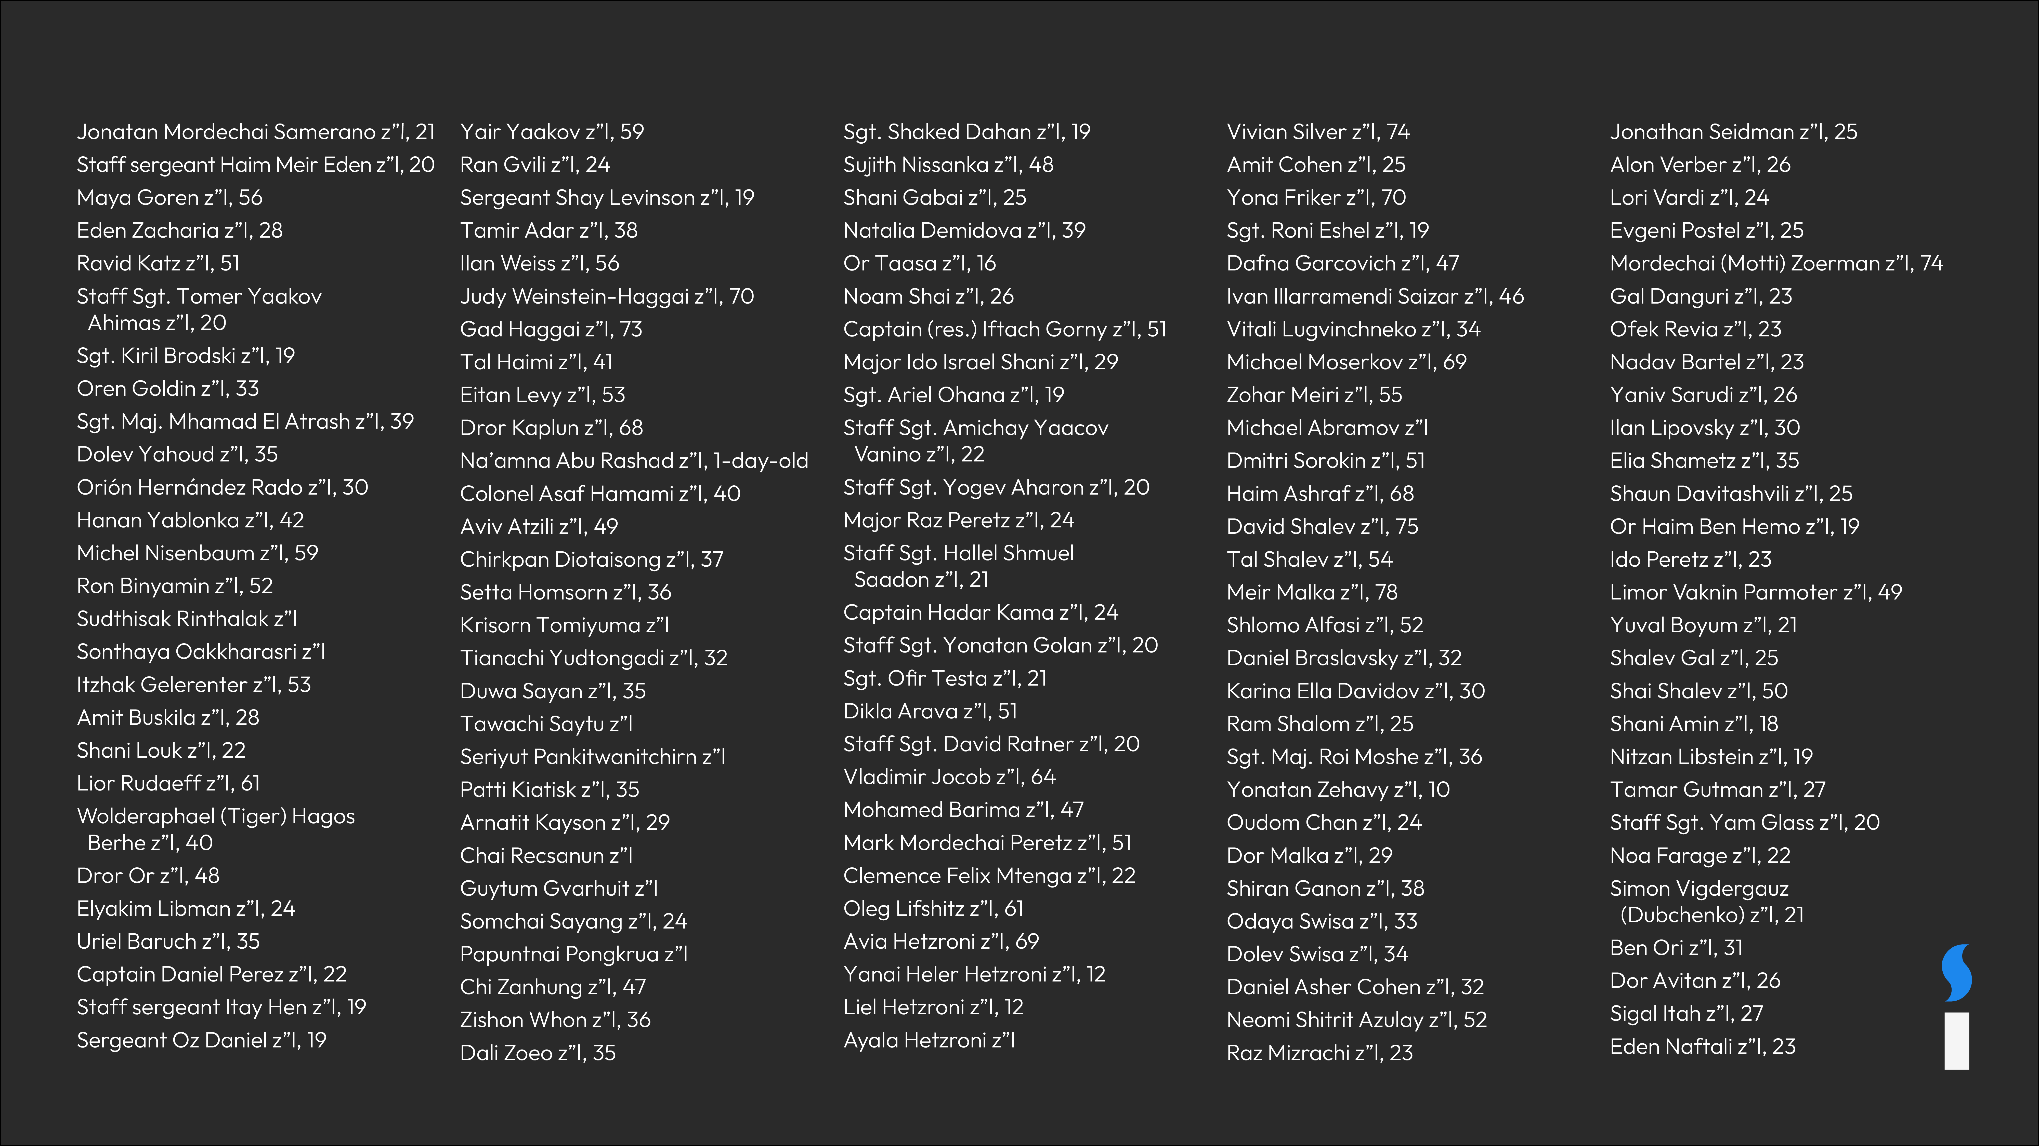
Victims of the October 7th Attacks

Slide 3
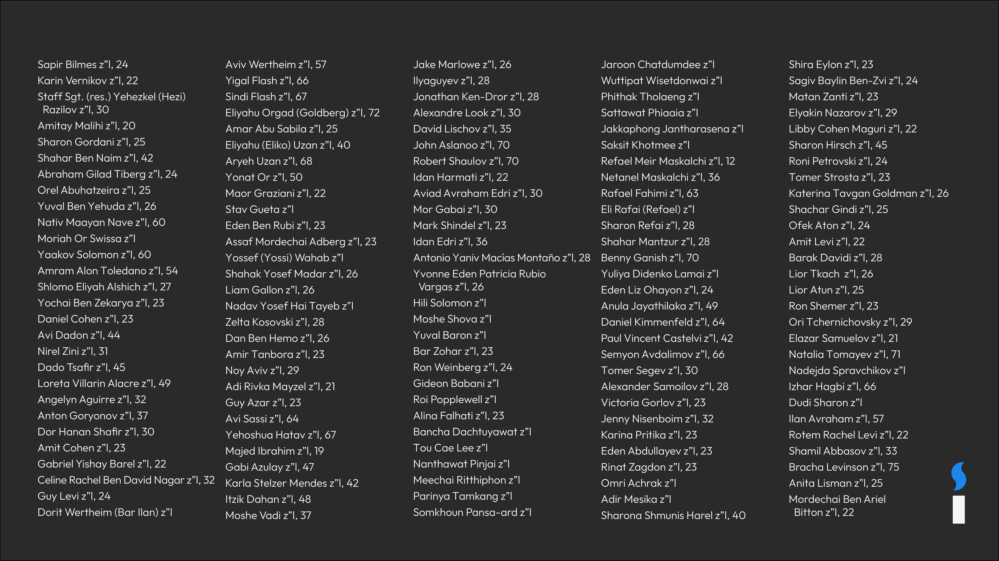
Victims of the October 7th Attacks

Slide 4
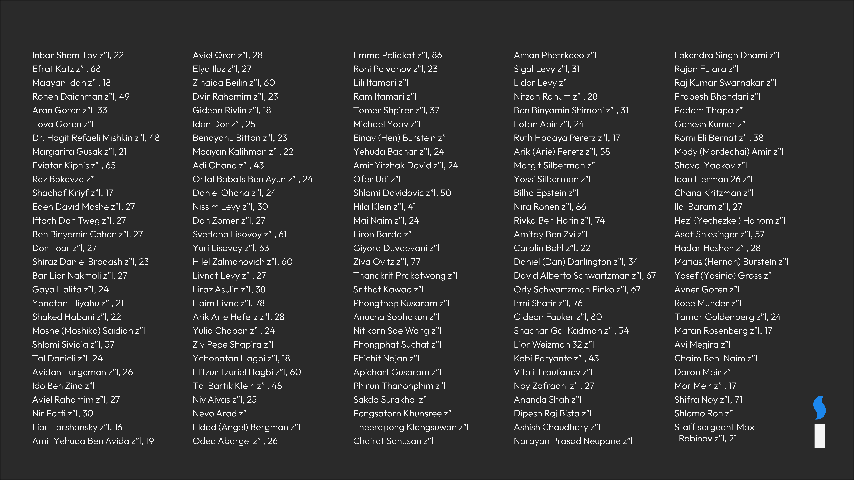
Victims of the October 7th Attacks

Slide 5
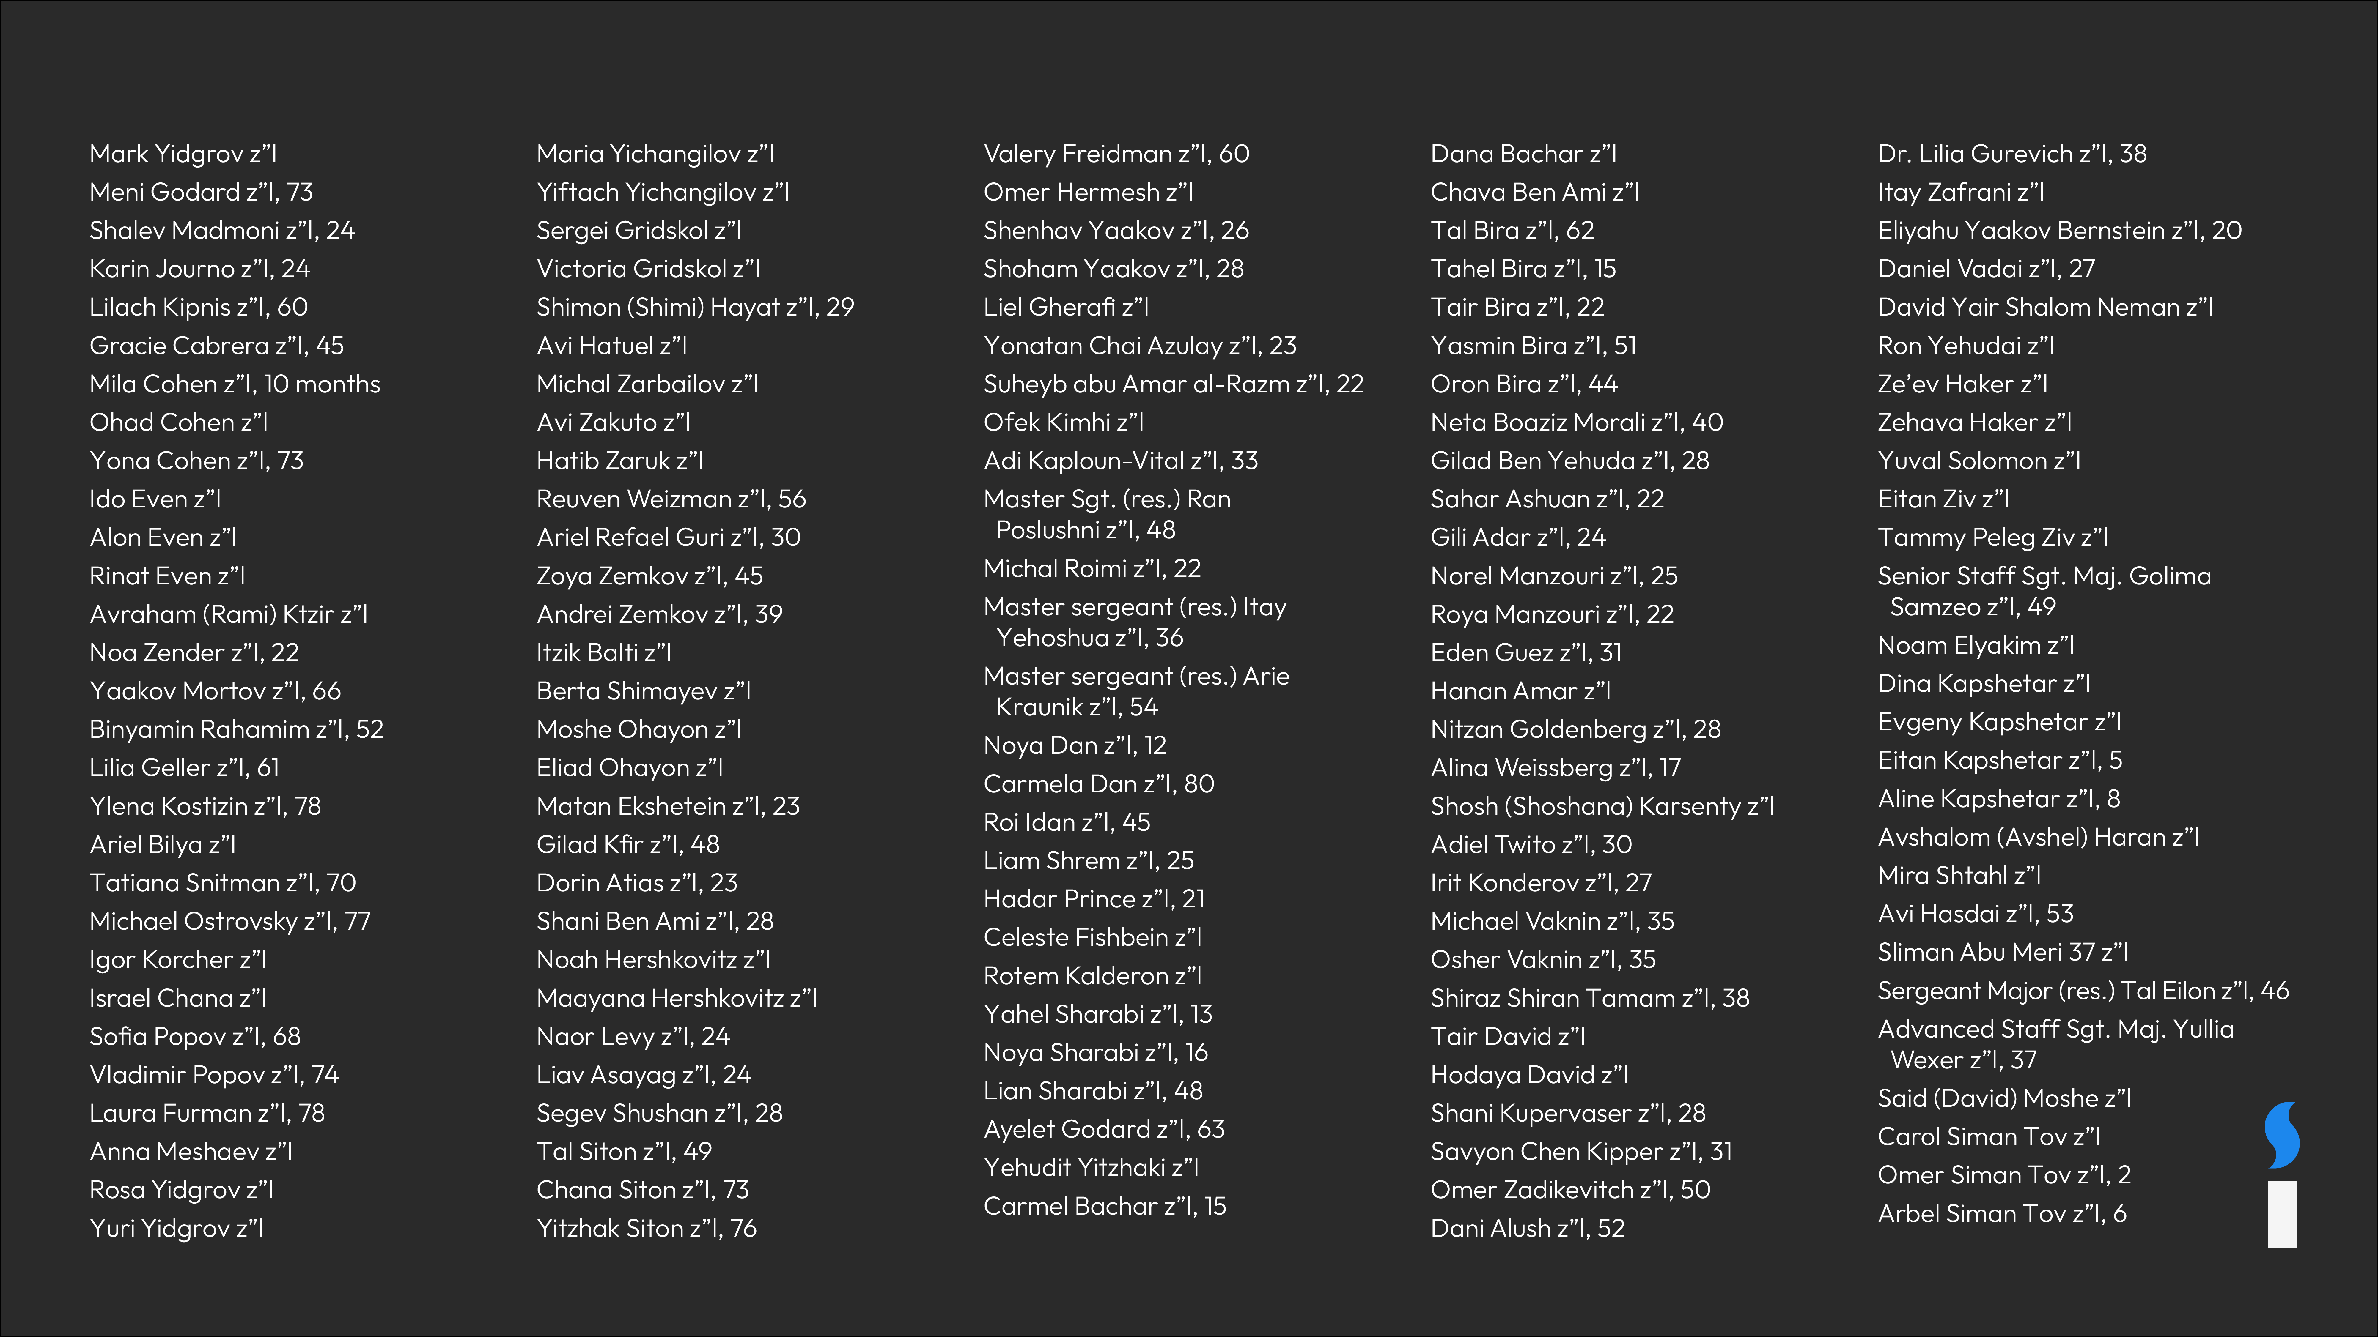
Victims of the October 7th Attacks

Slide 6
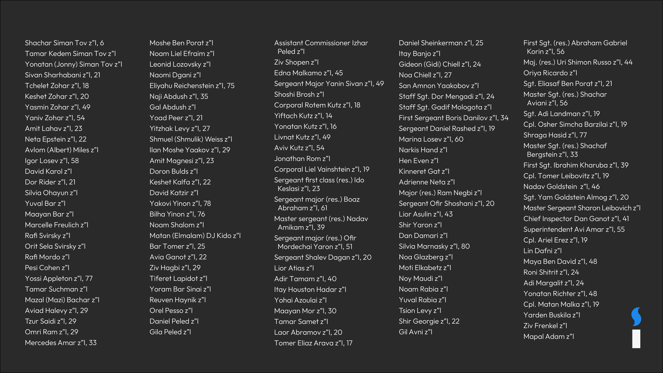
Victims of the October 7th Attacks

Slide 7
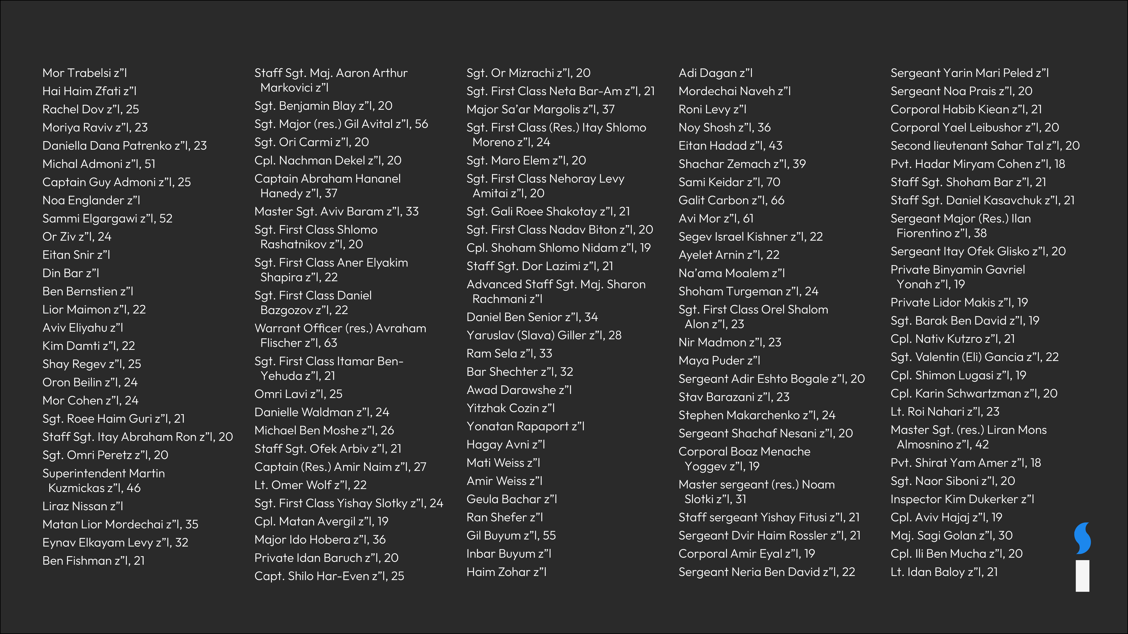
Victims of the October 7th Attacks

Slide 8
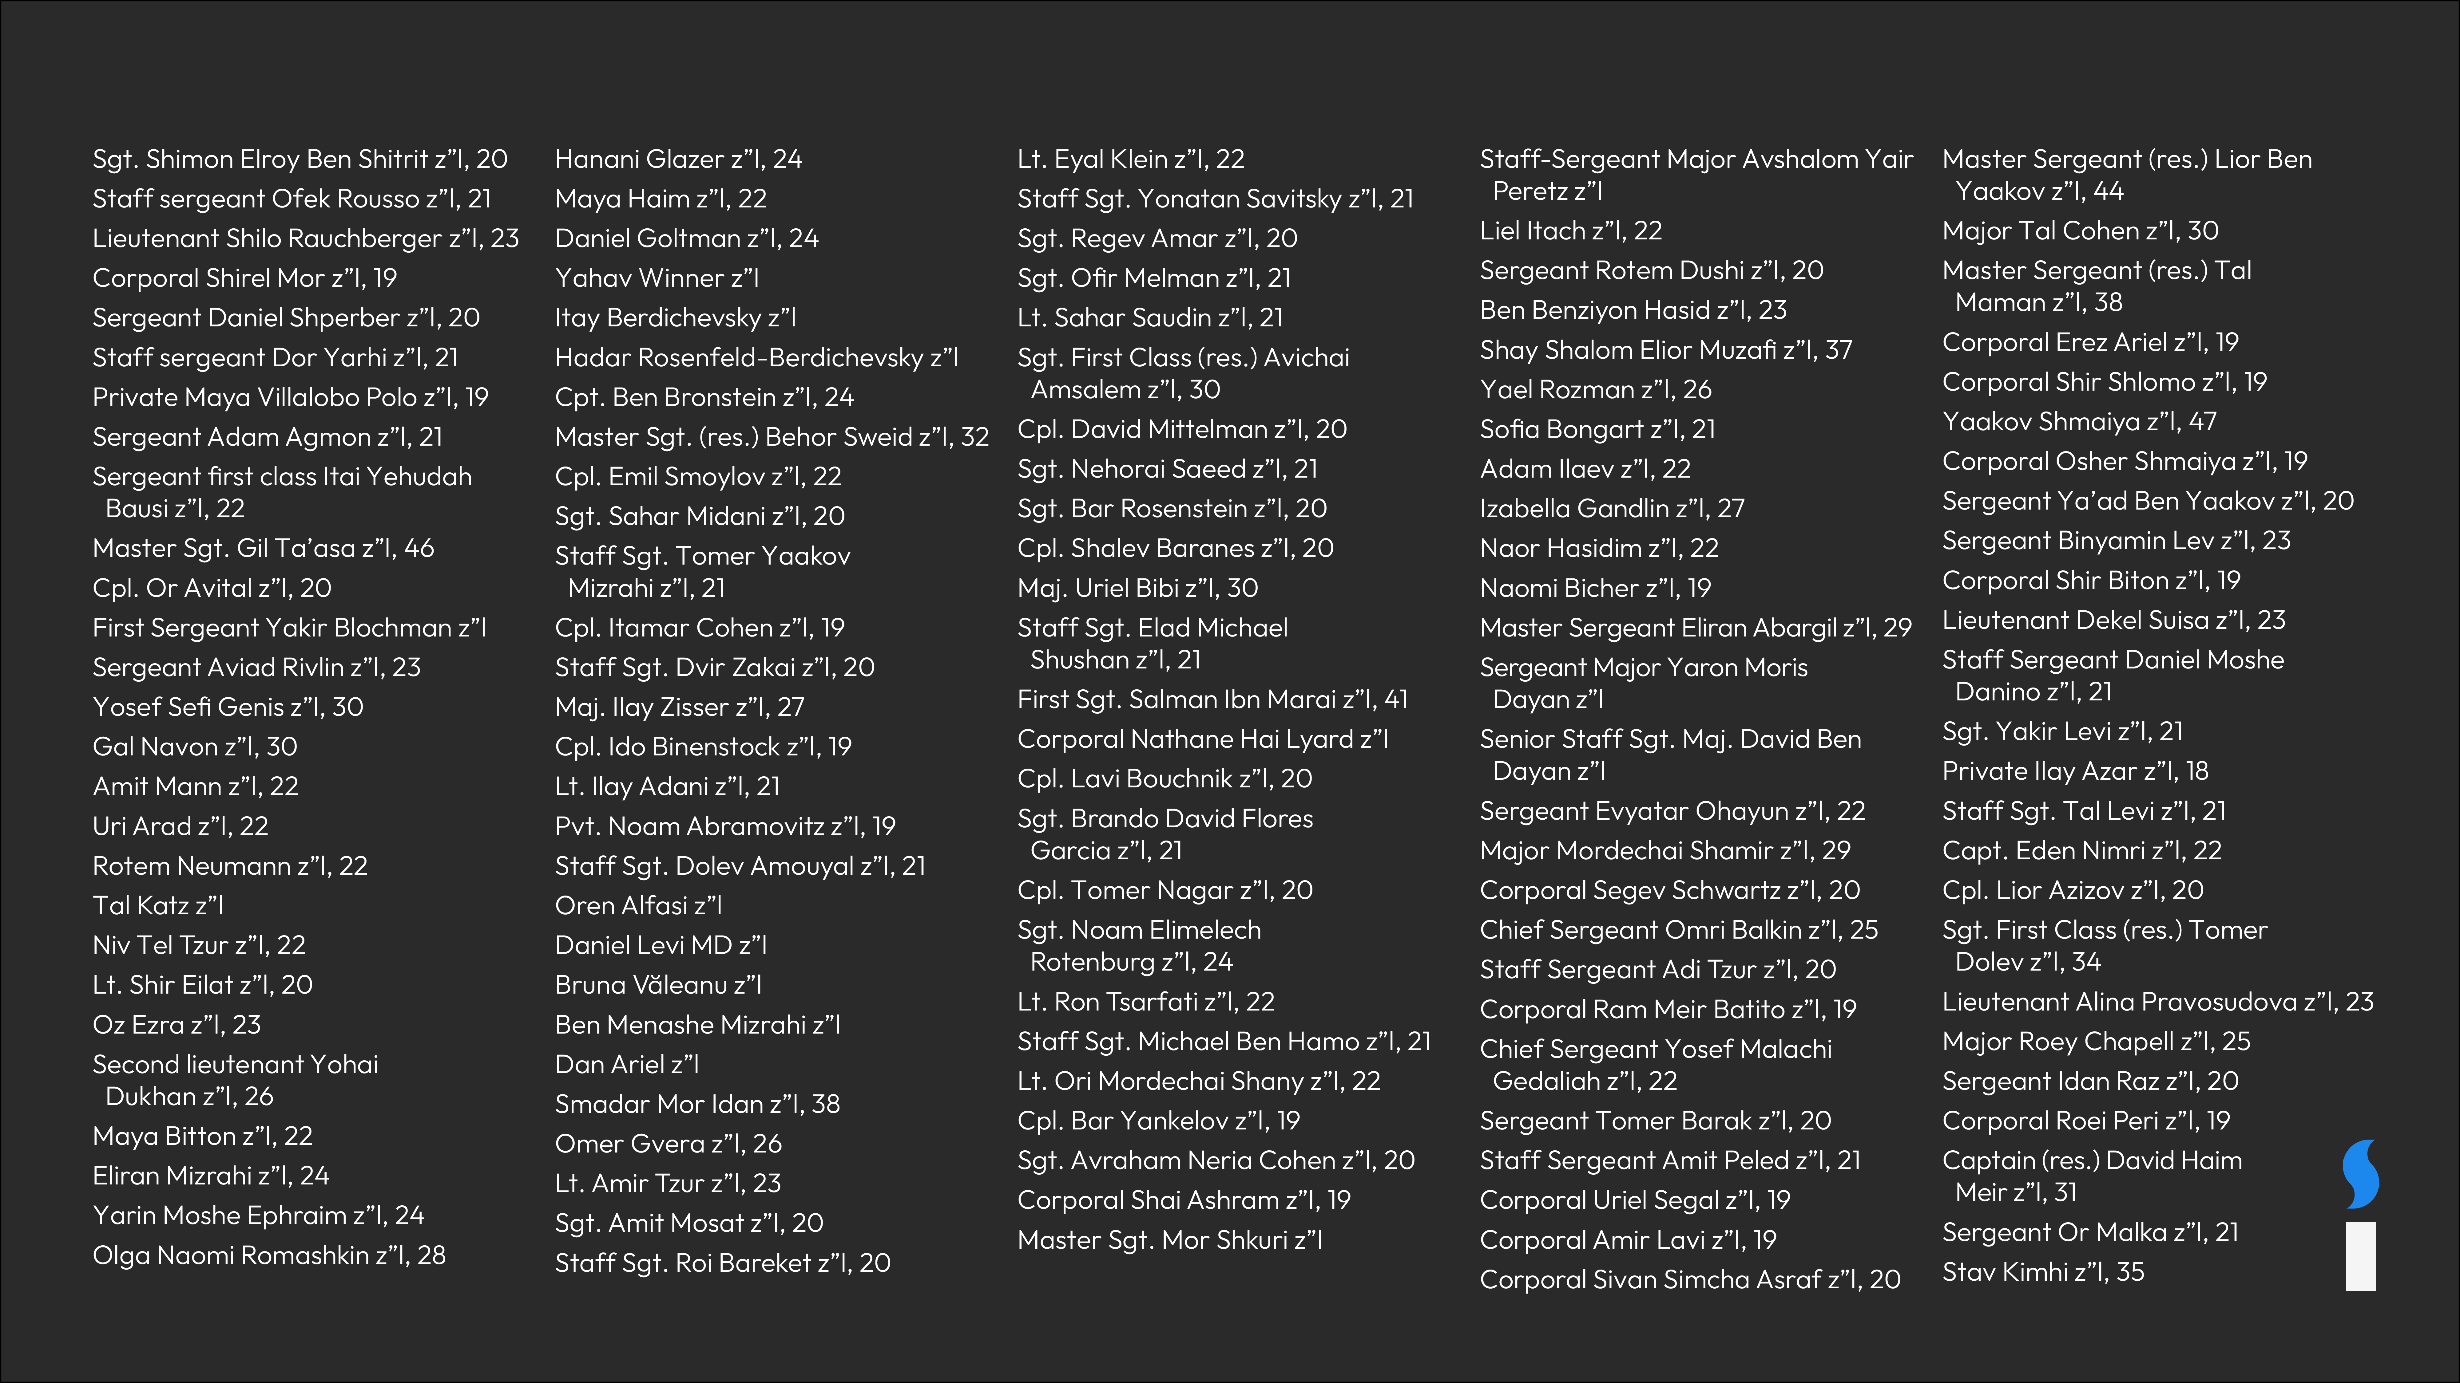
Victims of the October 7th Attacks

Slide 9
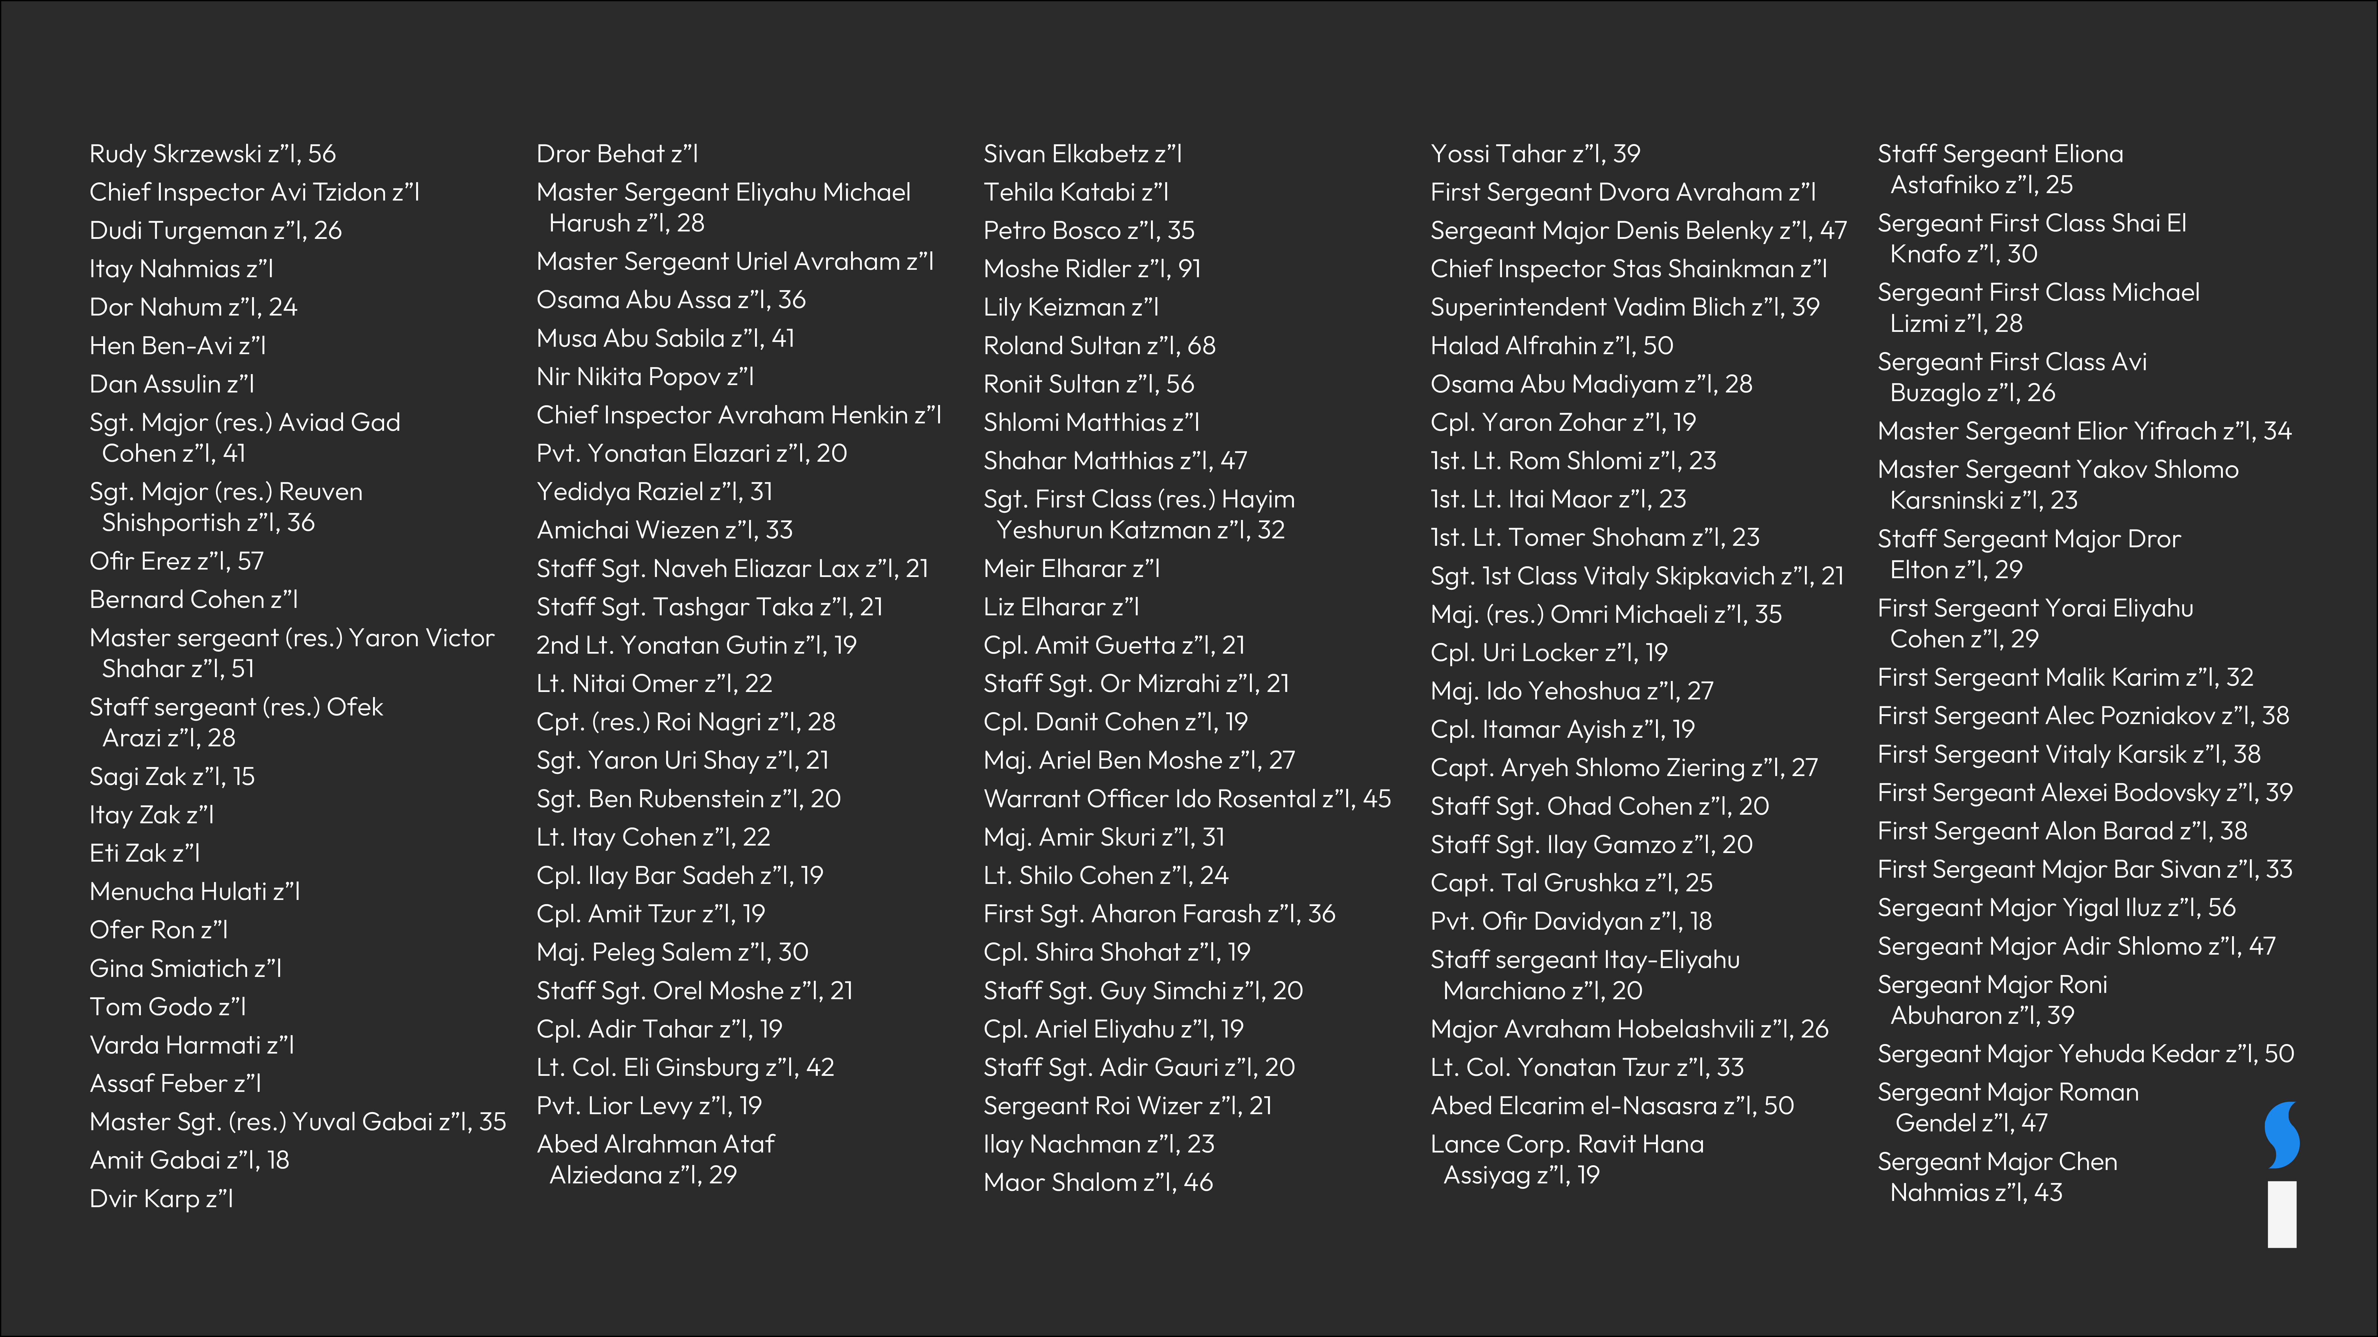
Victims of the October 7th Attacks

Slide 10
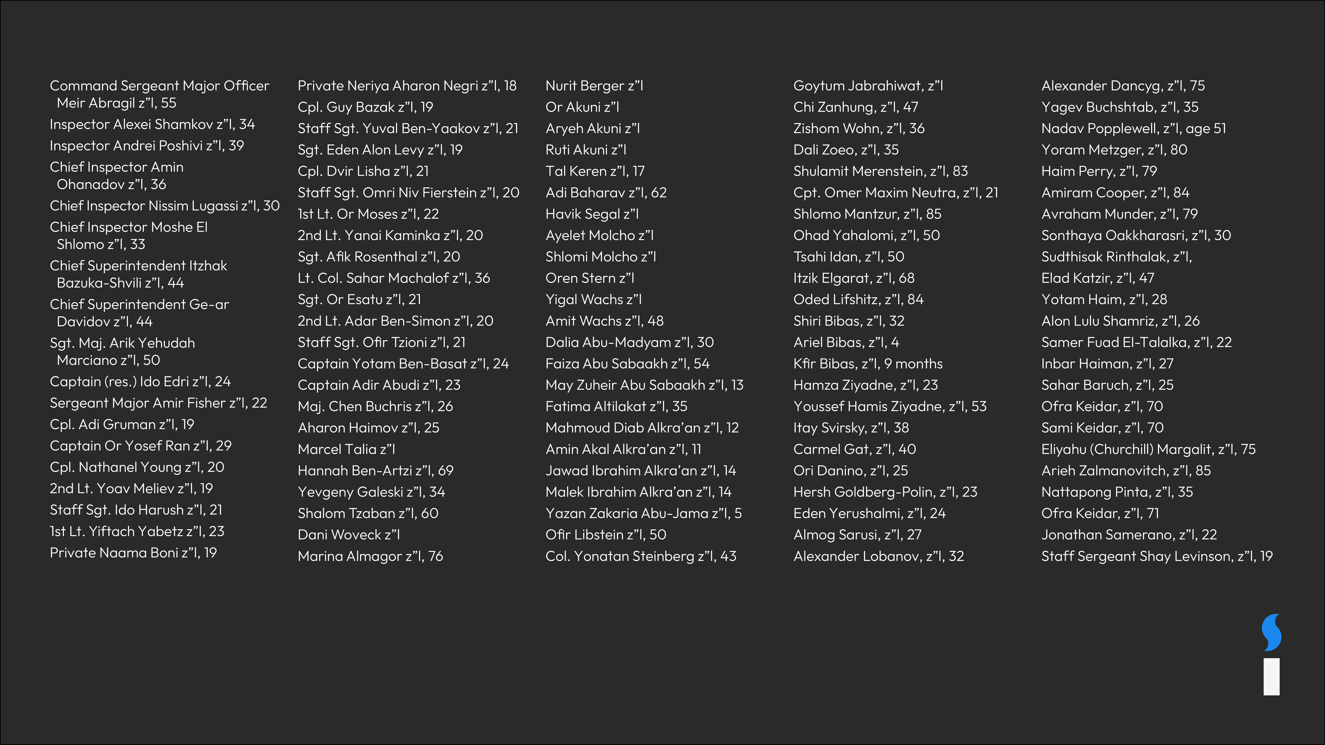
Victims of the October 7th Attacks

Slide 11
Victims of the Swords of Iron War*
October 8, 2023
*The following slides are only a selection of names of the fallen

Slide 12
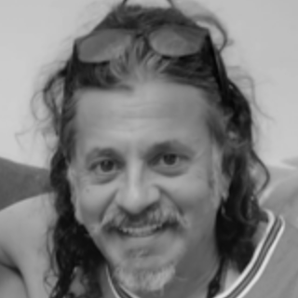
Adrian Marcelo Podzamczer z”l, 57

Slide 13
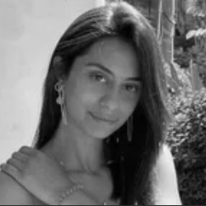
Eden Yerushalmi z”l, 24

Slide 14
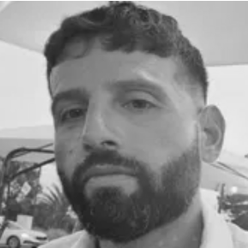
Chief Inspector Arik Ben-Eliyahu z”l, 37

Slide 15
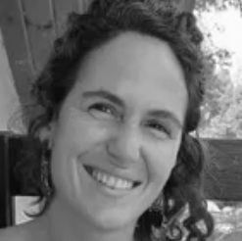
Carmel Gat z”l, 40

Slide 16
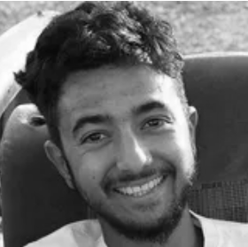
Hersh Goldberg-Polin z”l, 23

Slide 17
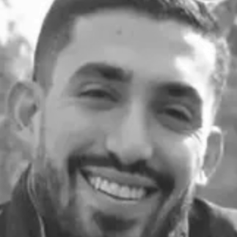
Master sergeant Ori Danino z”l, 24

Slide 18
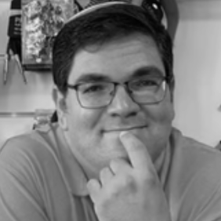
Gideon Peri z”l, 38

Slide 19
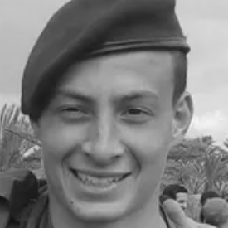
Sergeant Omer Ginzburg z”l, 19

Slide 20
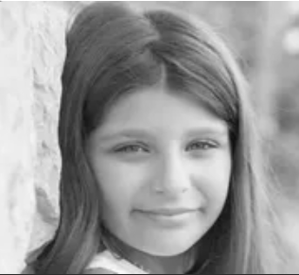
Alma Ayman Fakhr al-Din z”l, 11

Slide 21
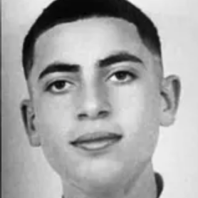
Fajr Laith Abu Saleh z”l, 16

Slide 22
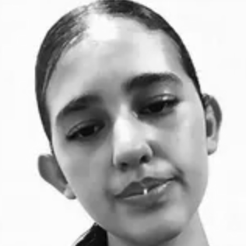
Iseel Nasha'at Ayoub z”l, 12

Slide 23
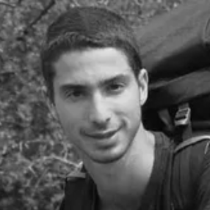
Yonatan Deutsch z”l, 23

Slide 24
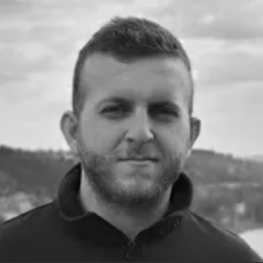
Major Jalaa Ibrahem z”l, 25

Slide 25
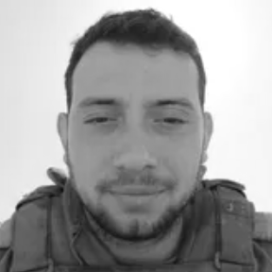
Captain Elay Elisha Lugasi z”l, 21

Slide 26

Major (res.) Eyal Avnion z”l, 25

Slide 27
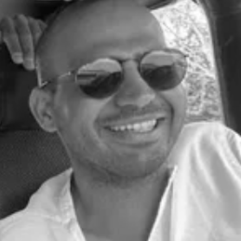
Lidor Levy z”l, 34

Slide 28
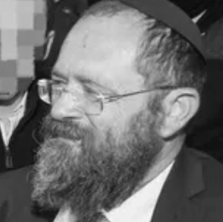
Yitzhak Zeiger z”l, 57

Slide 29
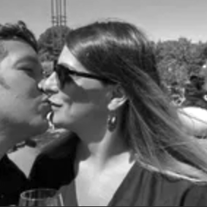
Noa Baranes z”l, 46

Slide 30
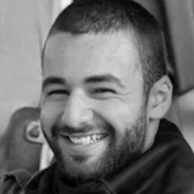
Staff sergeant Yair Avitan z”l, 20

Slide 31
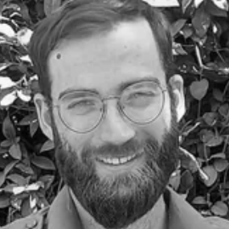
Sgt. 1st Class (res.) Malkia Gross z”l, 25

Slide 32
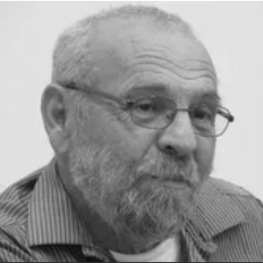
Alexander Dancyg z”l, 75

Slide 33
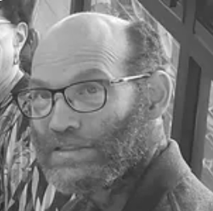
Nadav Popplewell z”l, 51

Slide 34
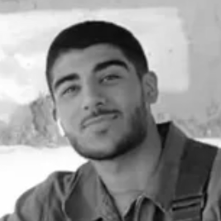
First sergeant Noam Douek z”l, 19

Slide 35
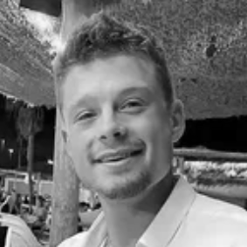
Sgt. 1st Class (res.) Omer Smadga z”l, 25

Slide 36
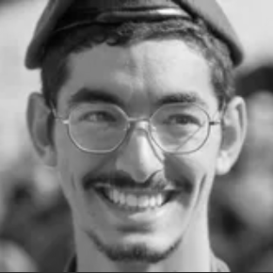
Sergeant Shalom Menachem z”l, 21

Slide 37
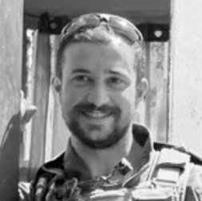
Captain Wassem Mahmoud z”l, 23

Slide 38
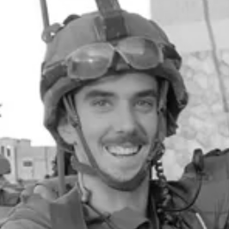
Major Tal Pshebilski Shaulov z”l, 24

Slide 39

Staff sergeant Eitan Karlsbrun z”l, 20

Slide 40
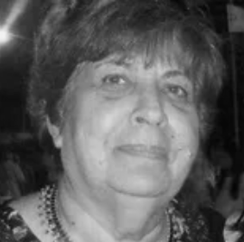
Mira Ayalon z”l, 76

Slide 41
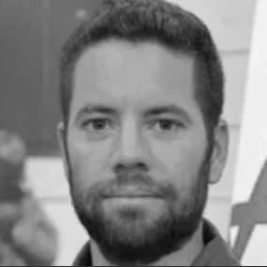
Chief Inspector Arnon Zamora z”l, 36

Slide 42
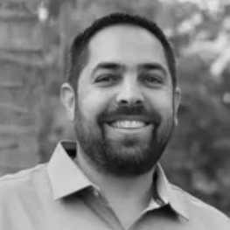
First sergeant (res.) Refael Kauders z”l, 39

Slide 43
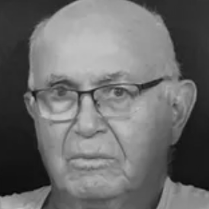
Amiram Cooper z”l, 84

Slide 44
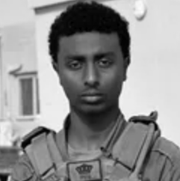
Sergeant Yosef Dassa z”l, 19

Slide 45
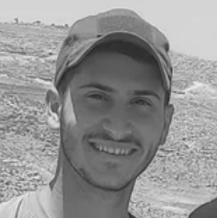
Staff sergeant Yedidya Azugi z”l, 21

Slide 46
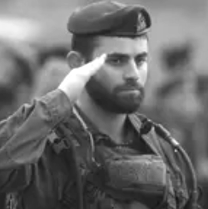
Major Gal Shabbat z”l, 24

Slide 47
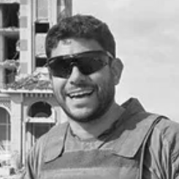
Sergeant major Ran Yavetz z”l, 39

Slide 48
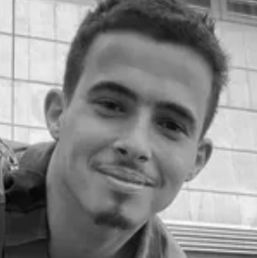
Sergeant Daniel Chemu z”l, 20

Slide 49
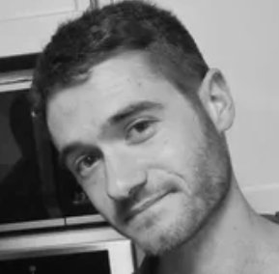
Captain Roy Beit Yaakov z”l, 22

Slide 50
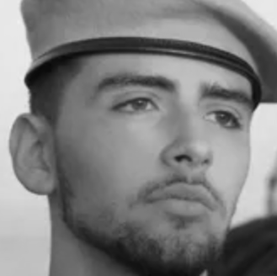
Staff sergeant Haim Sabach z”l, 20

Slide 51
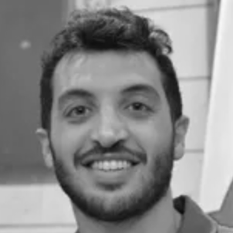
Chief Inspector Yitav Lev Halevi z”l, 28

Slide 52
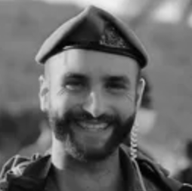
Major (res.) Dor Zimel z”l, 27

Slide 53
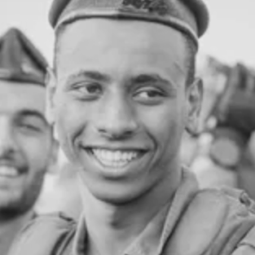
Staff sergeant Narya Belete z”l, 21

Slide 54
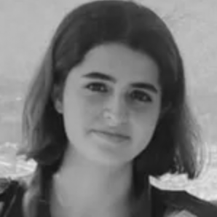
Staff sergeant Omer Sarah Benjo z”l, 20

Slide 55

Staff sergeant Nadav Cohen z”l, 20

Slide 56

Warrant officer Sebastian Haion z”l, 51

Slide 57

Sergeant Dolev Malka z”l, 19

Slide 58

Staff sergeant Avraham Wovagen z”l, 21

Slide 59

Staff sergeant Simon Shlomov z”l, 20

Slide 60

Sergeant first class Adi Eldor z”l, 21

Slide 61

Major (res.) Yitzhar Hofman z”l, 36

Slide 62

Sergeant Shai Germai z”l, 19

Slide 63

Captain (res.) Nir Binyamin z”l, 29

Slide 64

Sergeant first class (res.) Sagi Idan z”l, 24

Slide 65

Master sergeant (res.) Yoav Levi z”l, 29

Slide 66

Major Ilay Levy z”l, 24

Slide 67

Livia Dickman z”l, 24

Slide 68

Master sergeant Anwar Serhan z”l, 26

Slide 69

Itay Svirsky z”l, 38

Slide 70

Yossi Sharabi z”l, 51

Slide 71

Captain (res.) Ron Efrimi z”l, 26

Slide 72

Sergeant Roi Tal z”l, 19

Slide 73

Major Dvir David Fima z”l, 32

Slide 74

Sgt. Elisheva Rose Ida Lubin, 20

Slide 75

Staff sergeant Efraim Yachman z”l, 21

Slide 76

Master sergeant Maor Lavi z”l, 33

Slide 77

Staff sergeant Gal Hershko z”l, 20

Slide 78

Captain Oshri Moshe Butzhak z”l, 22

Slide 79

Lieutenant Shai Ayeli z”l, 21

Slide 80

Inbar Haiman z”l, 27

Slide 81

Captain (res.) Rotem Yoseff Levy z”l, 24

Slide 82

Captain Yarin Gahali z”l, 22

Slide 83

Yotam Haim z”l, 28

Slide 84

Sergeant Eran Aloni z”l, 19

Slide 85

Cpl. Noa Marciano z”l, 19

Slide 86

Sahar Baruch z”l, 24

Slide 87

Sergeant major (res.) Kobi Dvash z”l, 41

Slide 88

Cpl. Kamay Achiel, 18

Slide 89

Sergeant major (res.) Adi Shani z”l, 39

Slide 90

Staff Sgt. Eytan Dishon z”l, 21

Slide 91

Sgt. (res.) Adi Odaya Baruch, 22

